Slide 1
Complexity Classes
In computational complexity theory, a complexity class is a set of computational problems of related resource-based complexity. The two most commonly analyzed resources are time and memory.
Complexity classes are sets of related computational problems.

Slide 2
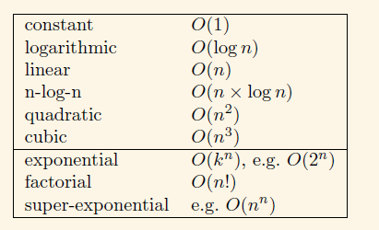
Complexity Classes
Let’s start by reminding ourselves of some common functions, ordered by how fast they grow.
Computer Scientists divide these functions into two classes:
Polynomial function:
Exponential function: (Super-Polynomial)

Slide 3
Polynomial Function
A polynomial is a mathematical expression constructed with constants and variables using the following operations:
Polynomial Example Degree
Constant: 1 0
Linear: 2x+1 1
Quadratic 3x²+2x+1 2
Cubic 4x³+3x²+2x+1 3
Quartic 5x⁴+4x³+3x²+2x+1 4
We can define ‘polynomial’ to be any function of the form:
a _{k} n ^{k} + a _{k−1} n ^{k−1} + . . . + a ₁ n + a ₀.

Slide 4
Polynomial Function
In algorithmic point of view, the polynomial function is defined as:
Any function that is O(n^{k} ), i.e. bounded from above by n^{k} for some constant k.
Alternatively, on an input of size n the worst-case running time is O(n^{k}) for some constant k.
e.g. O(1), O(log n), O(n), O(n × log n), O(n ² ), O(n ³ )
This is really a different definition of the word ‘polynomial’ from the original sense.
So, log n and n × log n, which are not polynomials in our original sense, are polynomials by our alternative definition, because they are bounded from above by, e.g., n and n² respectively.

Slide 5
Exponential Function
Exponential function (Super-Polynomial)
The lower section in considered as exponential functions.
e.g. O(2 ^{n}), O(n!), O(n ^{n})
Super-Polynomial function are:
Exponential: A function of the form k^{n} is genuinely exponential.
Some functions which are worse than polynomial but not quite exponential, such as O(n ^{log n})
Some functions which are worse than exponential, such as the super-exponentials, e.g. O(n ^{n}),

Slide 6
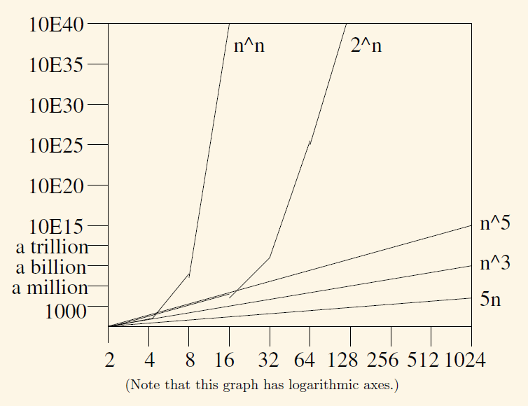
Computational Complexity

Slide 7
Complexity Classes
On the basis of this classification of functions into polynomial and exponential, we can classify algorithms:
Polynomial-Time Algorithm: A polynomial-time algorithm is an algorithm whose execution time is either given by a polynomial on the size of the input, or an algorithm whose order-of-magnitude time performance is bounded from above by a polynomial function.
What constitutes reasonable time?
– Standard working definition: polynomial time
Exponential-Time Algorithm: an algorithm whose order-of-magnitude time performance is not bounded from above by a polynomial function of input n.
Are all problems solvable in polynomial time?
– No: Turing’s “Halting Problem” is not solvable by any computer, no matter how much time is given.

Slide 8
Complexity Classes
Types of Problems
• Tractable
• Intractable
• Decision
• Optimization
Tractable Problem: a problem that is solvable by a polynomial-time algorithm. The upper bound is polynomial.
Intractable Problem: a problem that cannot be solved by a polynomial-time algorithm. The lower bound is exponential.

Slide 9
Complexity Classes
Here are examples of tractable problems (known polynomial-time algorithms):
Searching an unordered list, and an ordered list
Sorting a list
Multiplication of integers (even though there’s a gap)
Finding a minimum spanning tree in a graph (even though there’s a gap)
Here are examples of intractable problems (no polynomial-time algorithm).
Towers of Hanoi: we can prove that any algorithm that solves this problem must have a worst-case running time that is at least 2^{n} − 1.
List all permutations (all possible orderings) of n numbers.
For an n × n draughts board with an arrangement of pieces, determine whether there is a winning strategy for White (i.e. a sequence of moves, White is guaranteed to win). A worst-case running time that is at least 2^{n}.

Slide 10
Optimization/Decision Problems
Optimization Problems
– An optimization problem is one which asks, “What is the optimal solution to problem X?”
– Examples:
• 0-1 Knapsack
• Fractional Knapsack
• Minimum Spanning Tree
Decision Problems
– An decision problem is one with yes/no answer
– Examples:
• Does a graph G have a MST of weight ≤ W?

Slide 11
Optimization/Decision Problems
An optimization problem tries to find an optimal solution
• A decision problem tries to answer a yes/no question
• Many problems will have decision and optimization versions
– E. g.: Traveling salesman problem
Optimization: find hamiltonian cycle of minimum weight
Decision: is there a hamiltonian cycle of weight ≤ k

Slide 12
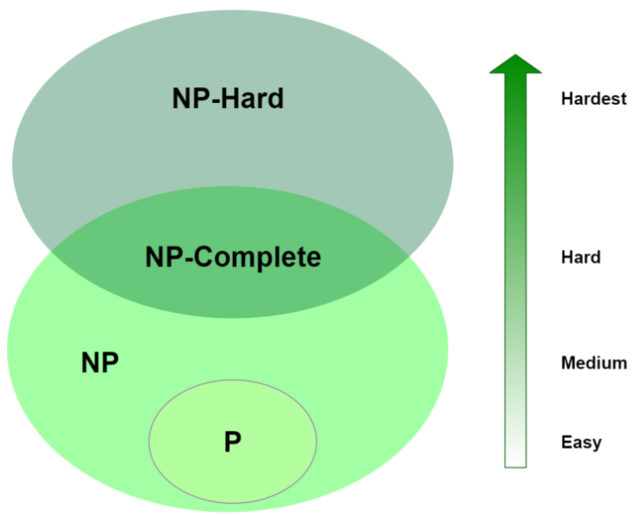
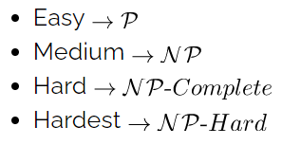
Complexity Classes

Slide 13
The Class P
The class of problems that have polynomial-time deterministic algorithms.
– That is, they are solvable in O(p(n)), where p(n) is a polynomial on n
– A deterministic algorithm is (essentially) one that always computes the correct answer.
Time complexity as:
T(n) = Ο(C*n^{k}) where C > 0 and K > 0, C and K constants and n input.
Many algorithms complete in polynomial time:
All basic mathematical operations; addition, subtraction, division, multiplication
Testing for primacy
Sorting problems;
Shortest Path Algorithms;
Linear and Binary Search Algorithms for a given set of numbers

Slide 14
The class NP
The second set of problems cannot be solved in polynomial time. However, they can be verified (or certified) in polynomial time. We expect these algorithms to have an exponential complexity, which we’ll define as:
T(n) = Ο(C₁*k^{C2*n}) where C₁ > 0 C₂ > 0 and K > 0, C₁, C₂ and K constants and n input.
If C₁ = C₂=1, then Ο(k ^{n})
NP: the class of decision problems that are solvable in polynomial time on a with a nondeterministic algorithm.
– A nondeterministic computer is one that can “guess” the right answer or solution.
• Algorithms are:
Integer Factorization
Graph Isomorphism
MST, Graph Coloring, Travelling Salesman
Satisfiability

Slide 15
The Class NP-complete
For example, if we have library functions to solve certain problem and if we can reduce a new problem to one of the solved problems, we save a lot of time.
A lot of times you can solve a problem by reducing it to a different problem. I can reduce Problem B to Problem A if, given a solution to Problem A, I can easily construct a solution to Problem B. (In this case, "easily" means "in polynomial time.“).
For any NP problem that’s complete, there exists a polynomial-time algorithm that can transfer the problem into any other NP complete problem.
Algorithms are:
Traveling Salesman
Knapsack
Graph Coloring

Slide 16
The Class NP-Hard
Our last set of problems contains the hardest, most complex problems in computer science. They are not only hard to solve but are hard to verify as well. In fact, some of these problems aren’t even decidable.
Among the hardest computer science problems are:
K-means Clustering
Traveling Salesman Problem and
Graph Coloring

Slide 17
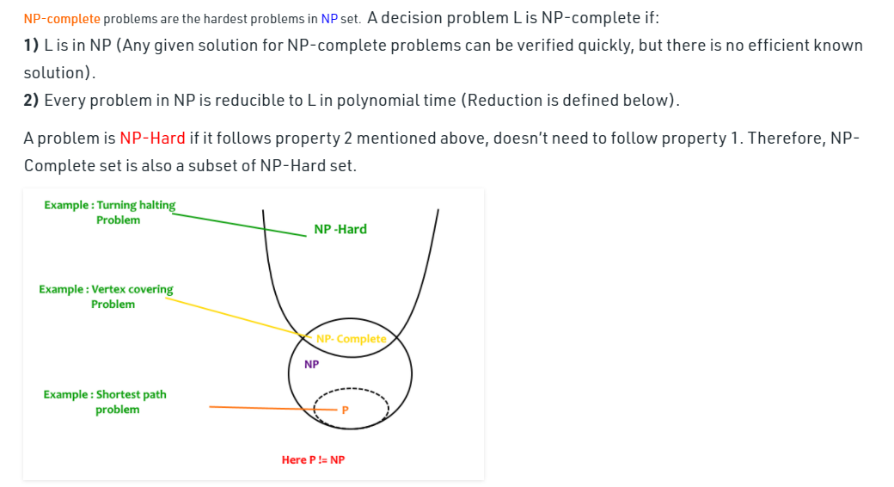
P!=NP

Slide 18
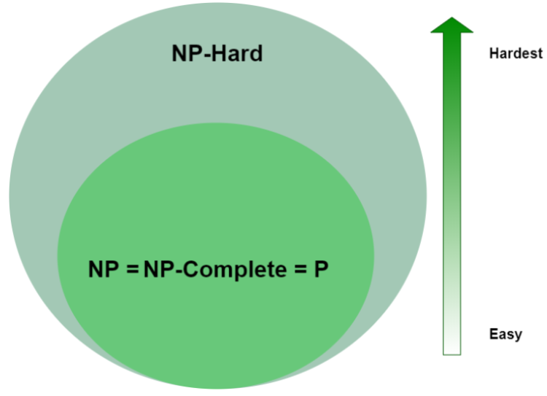
Does P=NP
it’s one of the Millennium Prize Problems for which there is a $1,000,000 prize.

Slide 19
Complexity Class Summary
P problems are quick to solve
NP problems are quick to verify but slow to solve
NP-Complete problems are also quick to verify, slow to solve and can be reduced to any other NP-Complete Problem
NP-Hard problems are slow to verify, slow to solve and can be reduced to any other NP problem

Slide 20
Questions??

